Slide 1
Information Security
Lecture:
The Threat Landscape
Course Instructor: Dr. Zainab ABaid

Slide 2
The Security Management Process
Plan
Protect
Respond

Slide 3
Context
Last week: the risk management aspect of planning in a high level way (without focusing on the concrete threats)
Now let’s zoom in on the actual threats.
This week: malware (threats) and cybercriminals (threat actors)

Slide 4

Threats
Introduction totMalware

Slide 5

Case Study: Carbanak
A classical example of a modern threat

Slide 6

Bank Robberies in the Past

Slide 7

Bank robberies today

Slide 8

Video
The Great Bank Robbery: Carbanak
https://www.youtube.com/watch?v=l61kYp_HDnA

Slide 9

https://forms.gle/y5Wnm1HRvTrb3NyQA

Slide 10
Malware
Malware Landscape
How do they infect hosts
How do they hide
How do they propagate
The Malware Zoo
How to detect them
Malware categories

Slide 11
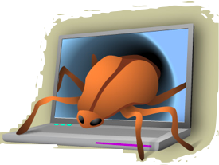
What is a malware ?
Malware is a set of instructions that run on your computer and make your system do something that an attacker wants it to do.

Slide 12
What it is good for ?
Steal personal information
1
Delete files
2
Click fraud
3
Steal software serial numbers
4
Use your computer as relay
5

Slide 13
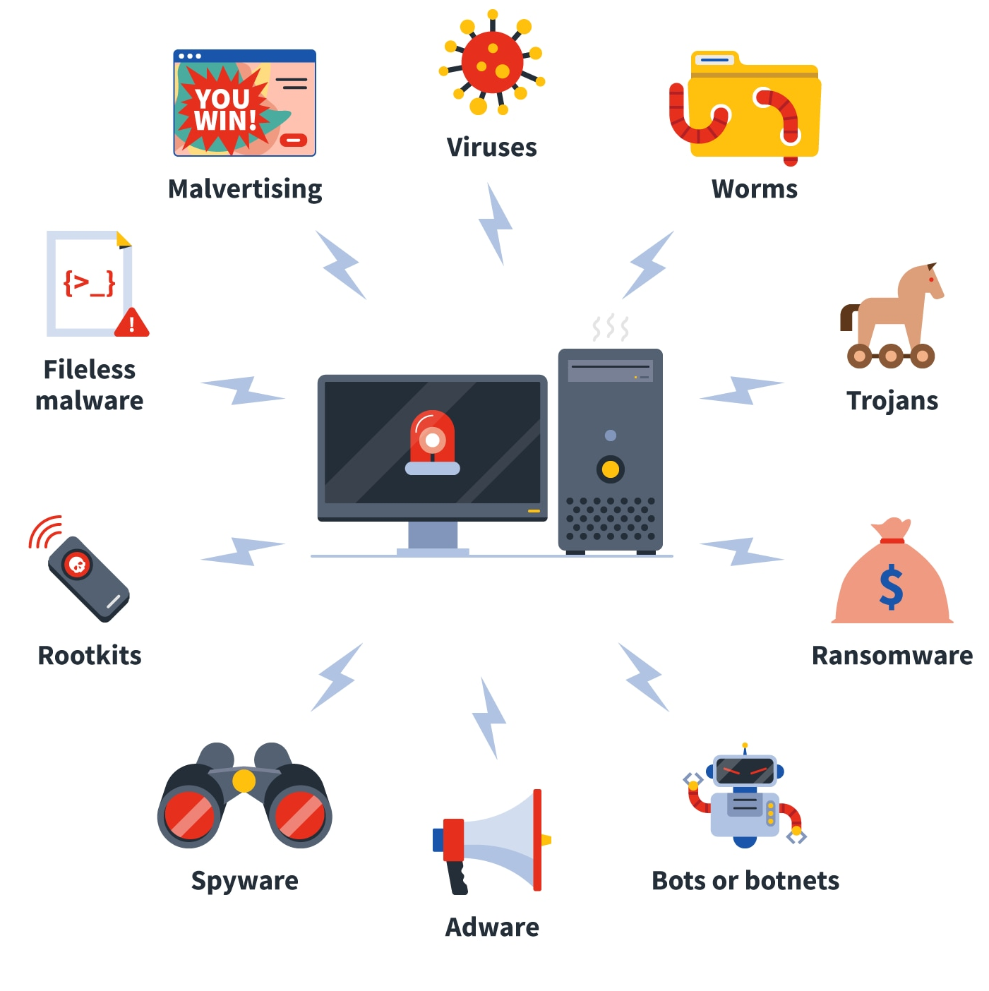
Malware, Malware everywhere
Notes:
Image Source: https://now.symassets.com/content/dam/norton/global/images/non-product/misc/tlc/in-post-01-types-of-malware.png

Slide 14
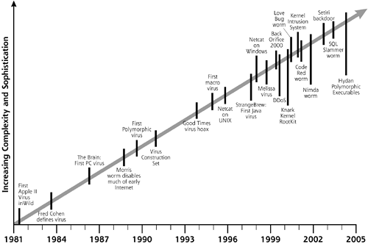
A brief history of malware

Slide 15
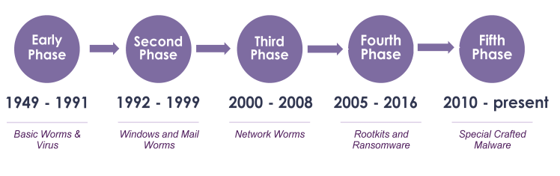
A brief history of malware (Contd.)
Source: https://www.researchgate.net/profile/Haneen-Alabdulrazzaq/publication/349324759/figure/fig1/AS:991564193095680@1613418734898/Malware-evolution-timeline-of-the-5-stages-21-Early-Phases-of-Malware-Evolution-1949.ppm

Slide 16
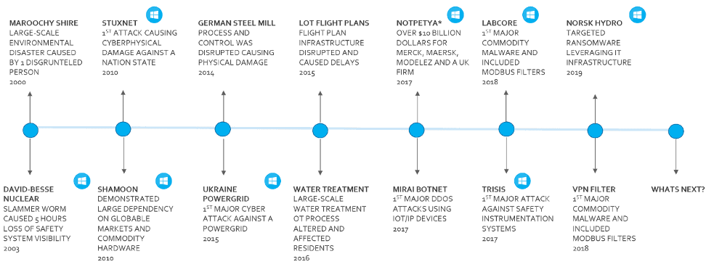
Evolution of malware attacks

Slide 17
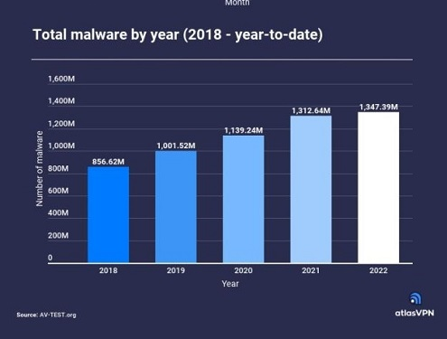
Malware samples continue to increase every year
Source: http://www.globalsecuritymag.com/IMG/jpg/-54.jpg

Slide 18
Malware
Malware Landscape
How do they infect hosts
How do they hide
How do they propagate
The Malware Zoo
How to detect them
Malware categories

Slide 19

What is a Virus ?
A program that can infect other programs by modifying them to include a, possibly evolved, version of itself.
-- Fred Cohen 1983

Slide 20
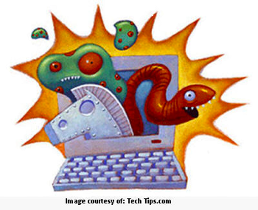
What is a worm?
A computer worm is a self-replicating computer program. It uses a network to send copies of itself to other nodes and do so without any user intervention.

Slide 21

What is a Trojan?
A trojan describes the class of malware that appears to perform a desirable function but in fact performs undisclosed malicious functions that allow unauthorized access to the victim computer.
-Wikipedia
Notes:
Image Source: https://www.eset.com/fileadmin/ESET/INT/Pages/Features_pages/trojan-horse.png

Slide 22
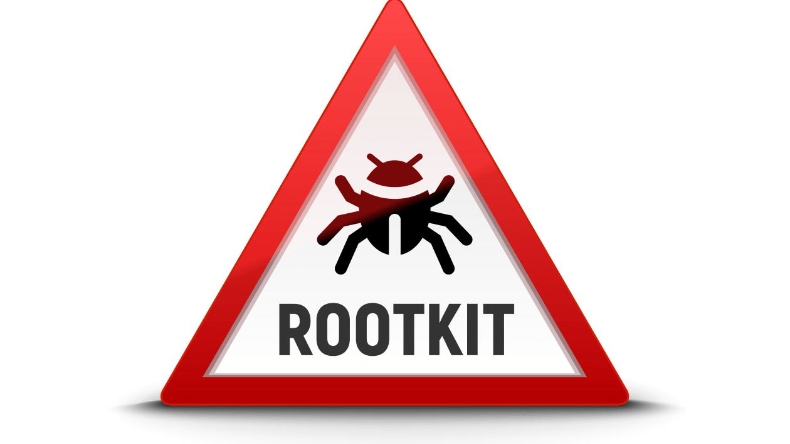
What is a Rootkit?
A rootkit is a software program, typically malicious, that provides privileged, root-level (i.e., administrative) access to a computer while concealing its presence on that machine.
-Imperva
Notes:
Key ideas:
System level or system wide access
Concealing itself or other malware to carry out nefarious activity unknown to you
Types:
User mode, kernel mode, firmware, hardware, bootkit.
Rootkit actions:
Hide itself or other malicious programs from users and anti virus software
Disable anti virus protection
Delete files
Information theft (keylogging)
Remote access (backdoor)
Detection:
• Signature-Based
This is the most common technique for malware detection. However, it is the least efficient as it is only effective for already detected and wide-spread rootkits. Signatures from known rootkits are used to detect if any of them exist on a system.
• Behavioural-Based
These detectors identify a abnormal behaviour on a computer system based on heuristics and behavioural patterns. These patterns are derived from certain activities typically found in rootkits. The advantage of the behavioural based technique compared to the previous one, is that it may detect previously unknown rootkits.
• Diff-Based / Cross view
The Diff-Based or Cross view approach is used mostly to detect kernel-mode rootkits by comparing two different views of the system for the same information by traversing the data structures. In this case, the rootkit detector will get a view of the system and a view obtained from system utilities and then compare them. A difference in the results returned by the two approaches signals the presence of a rootkit.
• Integrity check
Integrity checks can be performed in a system to check for unauthorized code alteration in system files. First, there is the need to run a one way function to calculate a hash for every system file when the system is still clean and then use it as baseline. When the need arises, a hash comparison is performed between the baseline hashes and the current version’s hashes.
Source: https://www.enisa.europa.eu/topics/csirts-in-europe/glossary/rootkits
Image source: https://media.itpro.co.uk/image/upload/s--X-WVjvBW--/f_auto,t_content-image-full-desktop@1/v1628536569/itpro/shutterstock_rootkit.jpg
Imperva article on rootkits:
https://www.imperva.com/learn/application-security/rootkit/

Slide 23
Blended threats
For example, you inadvertently download a trojan that actually executes rootkit code
Or a Worm spread itself across the network and it contains a dropper that drops a virus/trojan that executes rootkit code

Slide 24
Malware
Malware Landscape
How do they infect hosts
How do they hide
How do they propagate
The Malware Zoo
How to detect them
Malware categories

Slide 25

What to Infect
Executable
Kernel
Service
MBR
Hypervisor

Slide 26
Overwriting malware
Targeted
Executable
Malware
Malware

Slide 27
prepending malware
Malware
Targeted
Executable
Infected host
Executable
Malware

Slide 28
appending malware
Targeted
Executable
Infected
host
Executable
Malware
Malware

Slide 29
Cavity malware
Targeted
Executable
Infected host
Executable
Malware
Malware

Slide 30
Multi-Cavity malware
Targeted
Executable
Malware
Malware
Malware
Malware

Slide 31
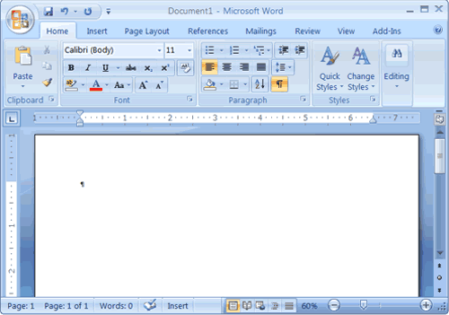
Document based malware
MS Office
Open Office
Acrobat
Notes:
General term for any document containing a virus, which will run automatically when the document is opened.
e.g. PDF files may contain malicious Javascript code.

Slide 32
Macro virus
Use the built-in script engine
Example of call back used (word)
AutoClose()
AutoOpen()
AutoNew()
Notes:
https://www.avast.com/c-macro-virus
A macro virus is a computer virus written in the same macro language as the software it infects — common victims include Microsoft Excel and Word. Because they target software rather than systems, macro viruses can infect any operating system. So a macro virus can infect a PC or Mac.
It’s called a macro virus because it’s written using a macro language. Without getting too technical, a macro language is a special-purpose command language that lets you easily automate certain sequences in specific applications.
Macro viruses specifically target this macro language and insert themselves into the automated processes. Software infected with a macro virus may be compelled to create new files, corrupt data, move text, send files, format hard drives, insert pictures, and deliver other, possibly even more destructive kinds of viruses or other types of malware.

Slide 33
Malware
Malware Landscape
How do they infect hosts
How do they hide
How do they propagate
The Malware Zoo
How to detect them
Malware categories

Slide 34
Evading signature based detection: Mutating Malware
Oligomorphic malware
Polymorphic malware
Metamorphic malware

Slide 35
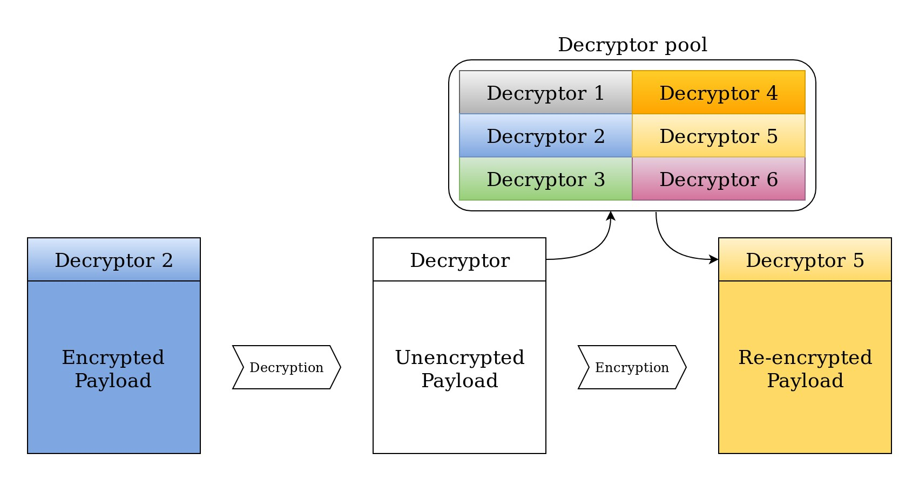
Oligomorphic MALWARE

Slide 36
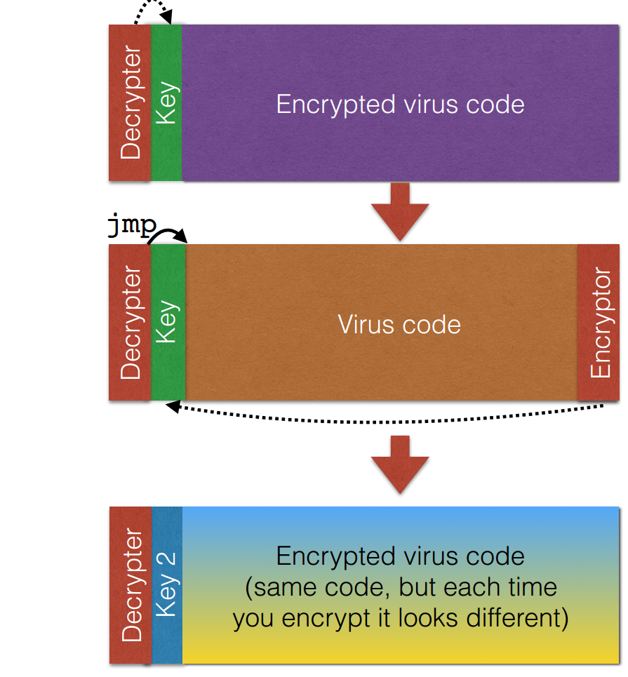
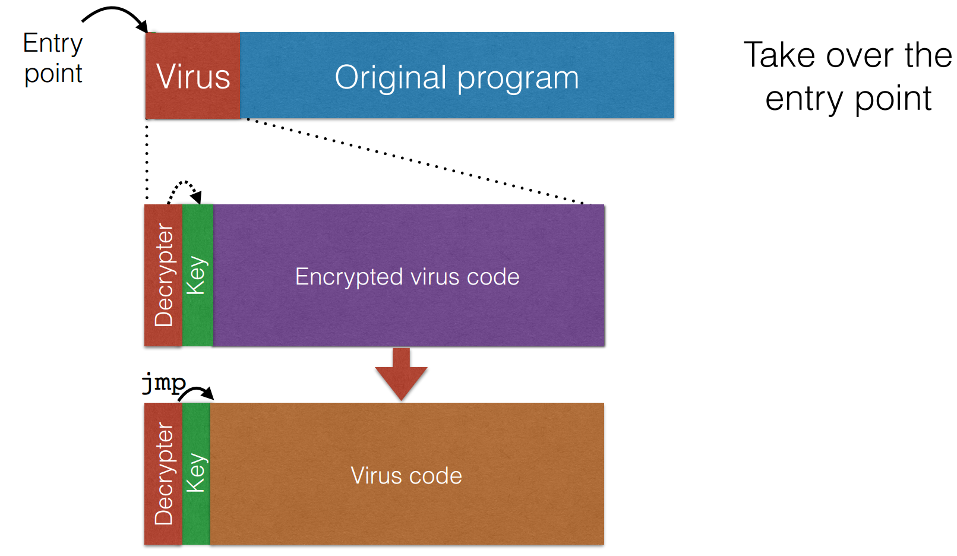
Polymorphic MALWARE

Slide 37
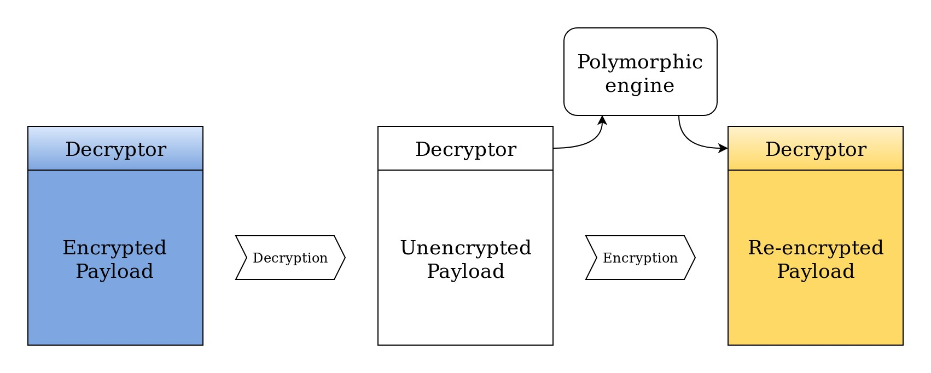
Polymorphic MALWARE

Slide 38
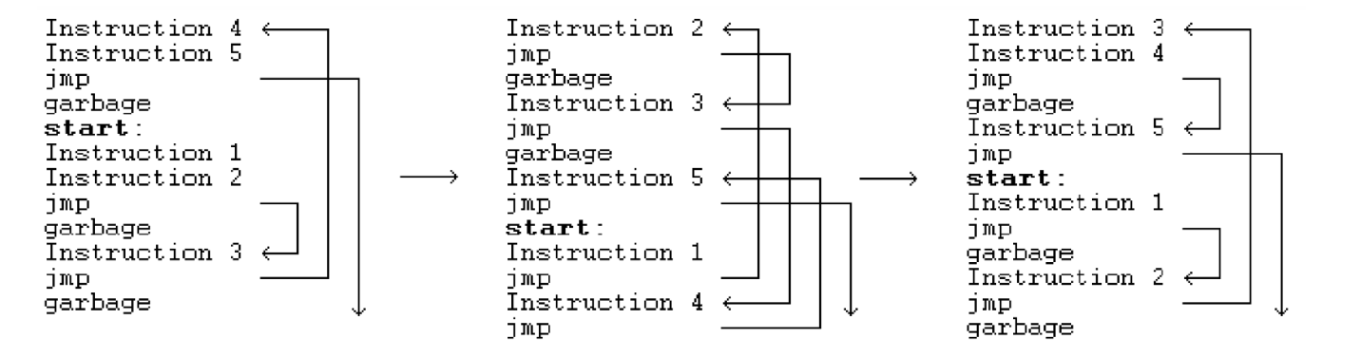
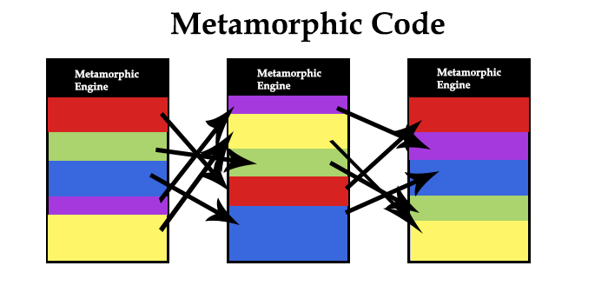
Metamorphic MALWARE

Slide 39
Packers
Packer
Payload
Malware
Infected host
Executable

Slide 40
Packer functionalities
Compress
Encrypt
Randomize (polymorphism)
Anti-debug technique (int / fake jmp)
Add-junk
Anti-VM
Virtualization
Notes:
Packer: basically a layer of code around the actual malicious code, to hide it. Unpacks itself in memory when packed file is executed. Self extracting archive.
Cybercriminals may pack (compress) the code many times, or may use different packers in successive generations, to make new variants.
Packers remain an effective way to slow down analysis.
Packers may add anti debugging and anti sandbox techniques.
Code virtualiztion: code runs inside a virtual environment when executed, so you never see the actual original malware’s assembly code (which analysis reveals otherwise). Most difficult to analyze this type of packer. Virtual machine software protection translates an executable's original code into a special format that only a special virtual machine can run. A virtual machine is then called to run this code

Slide 41
HOW ROOTKITS HIDE
For example, by changing the output of the ps or ls commands, to hide the presence of the rootkit code or the malicious process.
Basically by hooking into system calls
Or by disabling the anti virus program altogether.
Bootkits: infecting the BIOS (MBR or boot sector virus), so they load BEFORE the operating system, hence cannot be detected by software.

Slide 42
Malware
Malware Landscape
How do they infect hosts
How do they hide
How do they propagate
The Malware Zoo
How to detect them
Malware categories

Slide 43
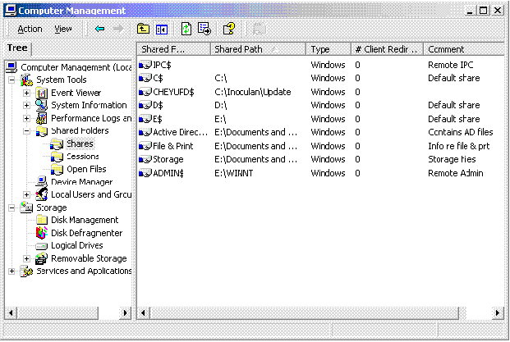
Shared folder

Slide 44
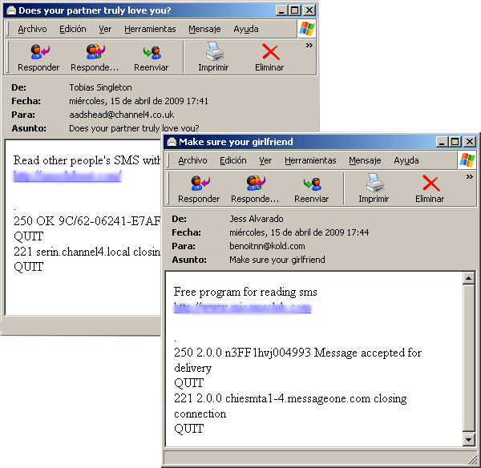
Email propagation

Slide 45
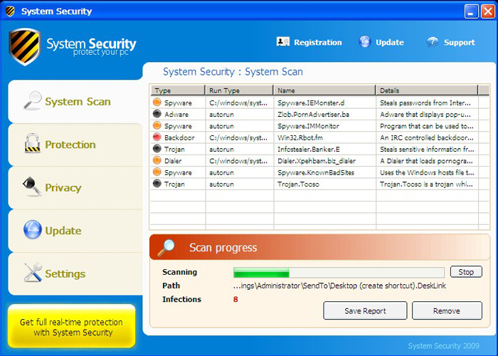
Fake antivirus (Trojans)

Slide 46
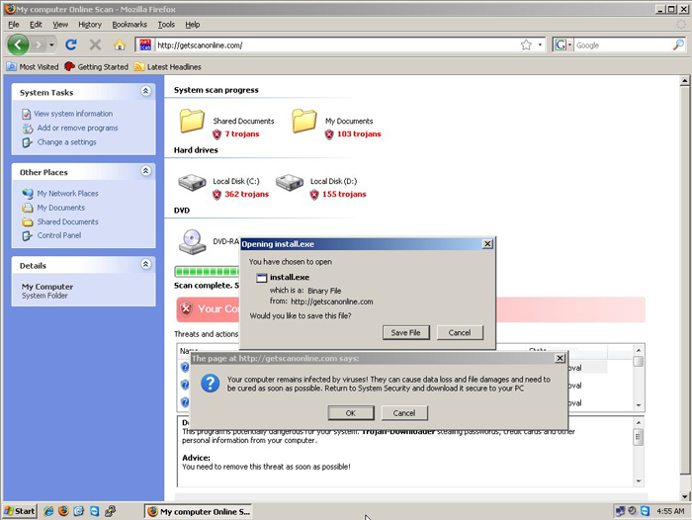
Fake page

Slide 47
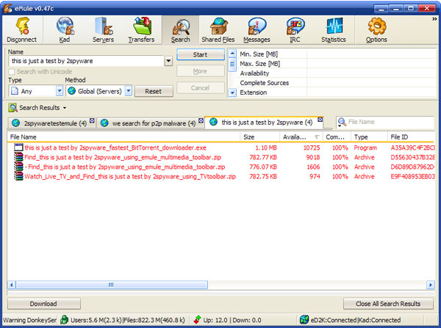
P2P Files
35.5% are malwares (Kalafut 2006)

Slide 48
Backdoor
InfectedHost
Attacker
InfectedHost
Attacker
TCP
TCP
Normal
Reverse
Notes:
Normal: attacker creates a backdoor, i.e. a TCP connection to an infected host.
Reverse: Step 1: attacker creates a listener on a particular port of his machine. Step 2, malware infects a host (say, a rootkit or trojan). Step 3, the malware then opens an outgoing connection to the attacker from the host. This allows bypassing firewalls which may not allow incoming connections. For example, servers may only allow connections on ports 443 and 80, but through a reverse shell, an attacker can get a webserver to create a connection to the attacker.

Slide 49
Backdoor
RDV
Point
InfectedHost
Attacker
InfectedHost
Attacker
ICMP
Covert
Rendevous
Notes:
Covert backdoor: one that uses a legitimate protocol to communicate b/w victim and attacker (or, basically, an infected machine and its controller). For example ICMP.
Rendevous point is a different server that both the attacker and infected host communicate with. For example, Conficker infected machines generate a set of domain names, one of which is registered and controlled by the attacker, and connect to that URL to read data that the attacker has placed there. (They were downloading executables according to this analysis: https://www.usenix.org/legacy/event/leet09/tech/full_papers/porras/porras_html/leet_paper.html)

Slide 50
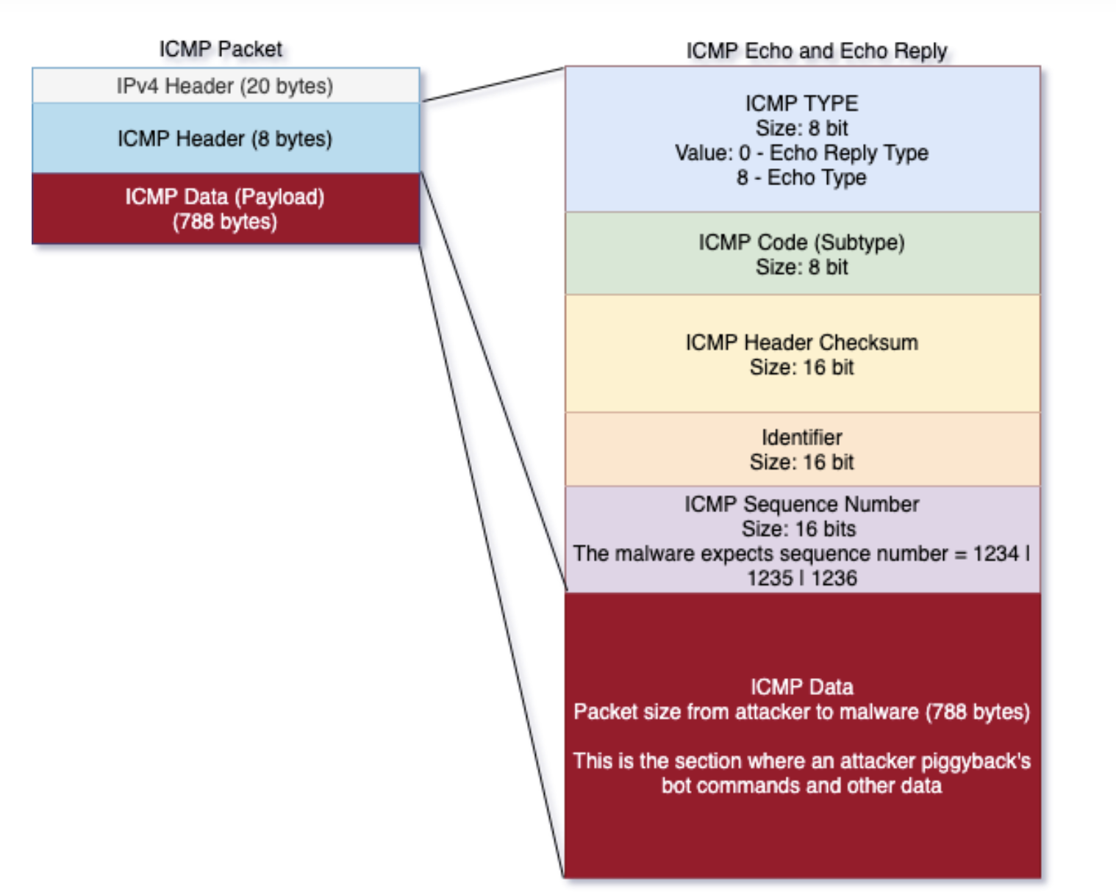
Pingback: An ICMP Based backdoor
The Pingback malware used this for its covert communications.
Pingback supports several commands including:
shell – execute a shell
download – 3 different modes of download are provided:
Mode 1: Infected host connects back to the attacker’s host (works well if incoming TCP connections are blocked by firewall)
Mode 2: Infected host opens a socket on a specified port and waits for the attacker to connect.
Mode 3: Purely ICMP-based, but this is very slow and the current implementation is not very reliable in terms of flow control.
upload – also supports 3 different modes, similar to the Download command.
exec – execute a command on the infected host.
Notes:
Prevention:
ICMP tunneling is not new, but this particular sample piqued our interest as a real-world example of malware using this technique to evade detection. ICMP is useful for diagnostics and performance of IP connections in the real world. It is very useful to have them enabled but must be balanced by real-world threats. While we are not suggesting that ICMP should be disabled, we do suggest putting in place monitoring to help detect such covert communications over ICMP.
For network administrators and technical audience, a rule can be implemented to check if a packet is an ICMP echo (type 8), the data size is 788 bytes or greater and check for ICMP sequence number: 1234, 1235 or 1236. Backdoor command strings such as “download”, “upload”, “exec”, “exep”, “rexec”, “shell” that found in an ICMP data packet can also be flagged.
Source: https://www.trustwave.com/en-us/resources/blogs/spiderlabs-blog/backdoor-at-the-end-of-the-icmp-tunnel/

Slide 51
How worms Propagate
Key: Parallelization.
Worms spread to n machines, each of the n machines spreads it out to n more machines, and so on.
Worm infections spread incredibly fast due to this (potentially 10 minutes to cover the entire Internet!)

Slide 52
How trojans propagate
User action (basically., stupidity).
Through browsers
Fake links/buttons
Fake ads.
Malicious apps

Slide 53
How Rootkits propagaTe
Through a dropper, which is a malicious piece of code usually attached to some benign file, e.g. cracked software
The dropper silently installs the rootkit and a loader executes it
Once execute, it may sit there and wait for instructions (e.g. by opening a backdoor) or doing pre defined malicious activities.

Slide 54
Video
The Code-Red Worm
https://www.youtube.com/watch?v=jXWDiDy3SDM

Slide 55
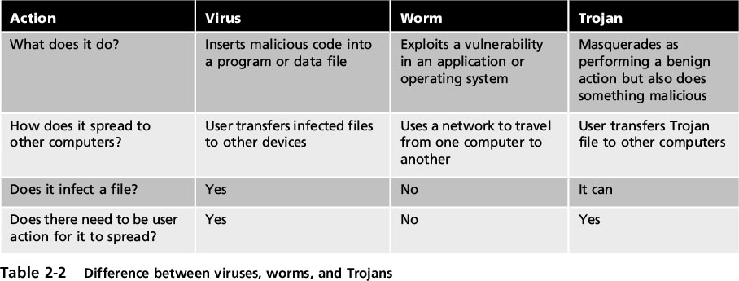
Virus vs. Worm vs. Trojan

Slide 56
Malware
Malware Landscape
How do they infect hosts
How do they hide
How do they propagate
The Malware Zoo
How to detect them
Malware categories

Slide 57
Contemporary Malware
Fileless Malware
Ransomware
Advanced Persistent Threats
Cryptominers
Wiper Malware

Slide 58
Fileless malware
Unlike file-based attacks, fileless malware does not leverage traditional executable files. Fileless attacks abuse tools built-in to the operating system to carry out attacks. Essentially, Windows is turned against itself.
Without an executable, there is no signature for antivirus software to detect. This is part of what makes fileless attacks so dangerous - they are able to easily evade antivirus products.
Fileless attacks use a technique called living-off-the-land. Living-off-the-land is when attackers use legitimate tools for malicious purposes, and has been around for at least twenty five years. The abused, legitimate tools are known as LOLBins, and can include Microsoft Office Macros, PowerShell, WMI, and many more system tools.
Example: Attackers may commence a fileless attack through the use of stolen credentials so they can access their target under the guise of a legitimate user. Once inside, the attacker can use native tools such as Windows Management Instrumentation (WMI) or PowerShell to conduct their attack. They can establish persistence by hiding code in the registry or the kernel, or by creating user accounts that grant them access to any system they choose.
Notes:
Sources:
https://www.cybereason.com/blog/fileless-malware
https://www.crowdstrike.com/cybersecurity-101/malware/fileless-malware/#:~:text=Fileless%20malware%20is%20a%20type,making%20it%20hard%20to%20detect.

Slide 59
ransomware
Colonial Pipeline Attack, May 2021
https://www.youtube.com/watch?v=wYKXn8Gfpi8
Notes:
More videos on this hack:
https://www.youtube.com/watch?v=qJM5zG9XhZ8

Slide 60

Case Study: WannaCry
https://www.youtube.com/watch?v=-bZhmcp0UDQ
https://thehackernews.com/images/-9RR9oKGt5SE/WRnQ-ABMDaI/AAAAAAAAsqQ/t9fGmbmEYCo9PSqPRMGa9F-t8Y_76iOywCLcB/s728-e100/how-to-wannacry-ransomware.png
Notes:
Required reading:
https://www.kaspersky.com/resource-center/threats/ransomware-wannacry

Slide 61
Cryptominers/Cryptojacking
Cryptojacking (also called malicious cryptomining) is an online threat that hides on a computer or mobile device and uses the machine’s resources to “mine” forms of online currency known as cryptocurrencies. Malicious cryptominers often come through web browser downloads or rogue mobile apps. Cryptojacking can compromise all kinds of devices, including desktops, laptops, smartphones, and even network servers.
Cryptomining: the process of solving complex math puzzles first, against a monetary reward in a cryptocurrency.
Instead of building a dedicated cryptomining computer, hackers use cryptojacking to steal computing resources from their victims’ devices. When you add all these resources up, hackers are able to compete against sophisticated cryptomining operations without the costly overhead.
Cryptojackers have more than one way to enslave your computer. One method works like classic malware. You click on a malicious link in an email and it loads cryptomining code directly onto your computer.
An alternative cryptojacking approach is sometimes called drive-by cryptomining. Similar to malicious advertising exploits, the scheme involves embedding a piece of JavaScript code into a web page. After that, it performs cryptocurrency mining on user machines that visit the page.
Notes:
Source: https://www.malwarebytes.com/cryptojacking
In early instances of drive-by cryptomining, web publishers caught up in the bitcoin craze sought to supplement their revenue and monetize their traffic by openly asking visitors’ permission to mine for cryptocurrencies while on their site.
More malicious versions of drive-by cryptomining don’t bother asking for permission and keep running long after you leave the initial site. This is a common technique for owners of dubious sites, or hackers that have compromised legitimate sites. Users have no idea that a site they visited has been using their computer to mine cryptocurrency. The code uses just enough system resources to remain unnoticed. Although the user thinks the visible browser windows are closed, a hidden one stays open. Usually it’s a pop-under which is sized to fit under the task bar or behind the clock.

Slide 62
How prevalent is cryptojacking
Feb. 2017
In February 2018, Malwarebytes Labs published that malicious cryptomining had become the most common detection type since September 2017.
Oct. 2017
In October 2017, Fortune suggested that cryptojacking is the next major security threat.
2018
In the first quarter of 2018, we saw a 4,000 percent increase in detections of Android-based cryptojacking malware.

Slide 63
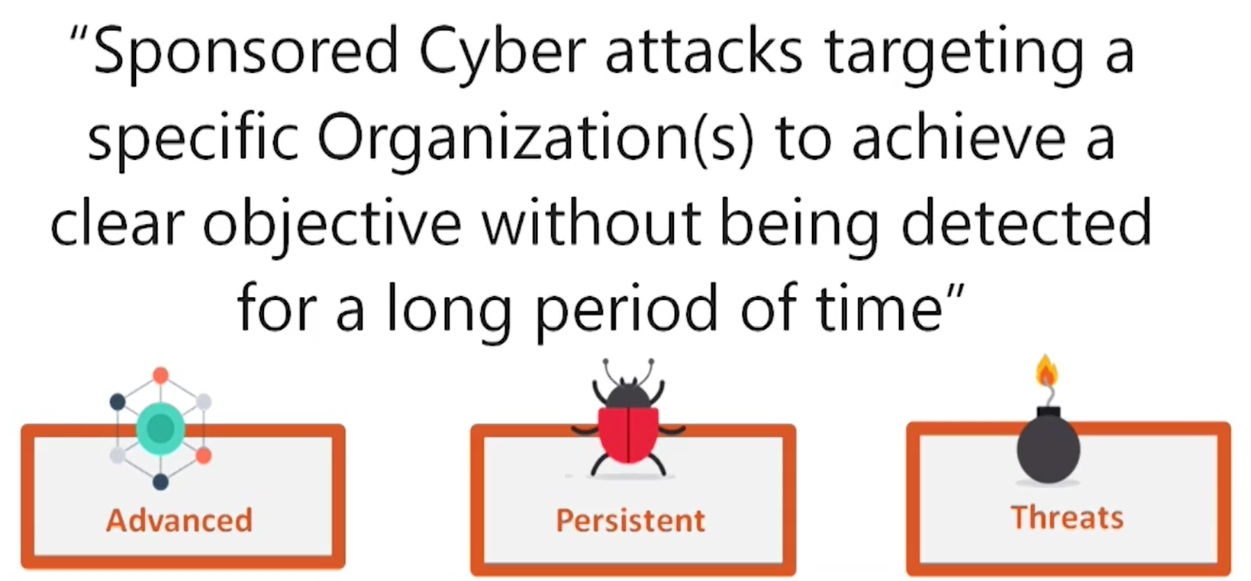
Advanced Persistent Threats

Slide 64
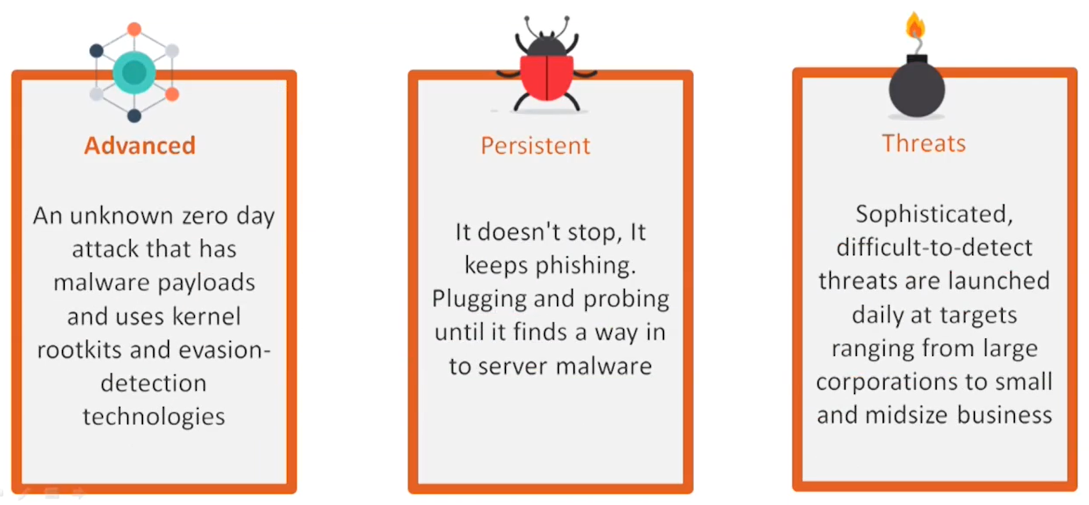
Advanced Persistent Threats

Slide 65
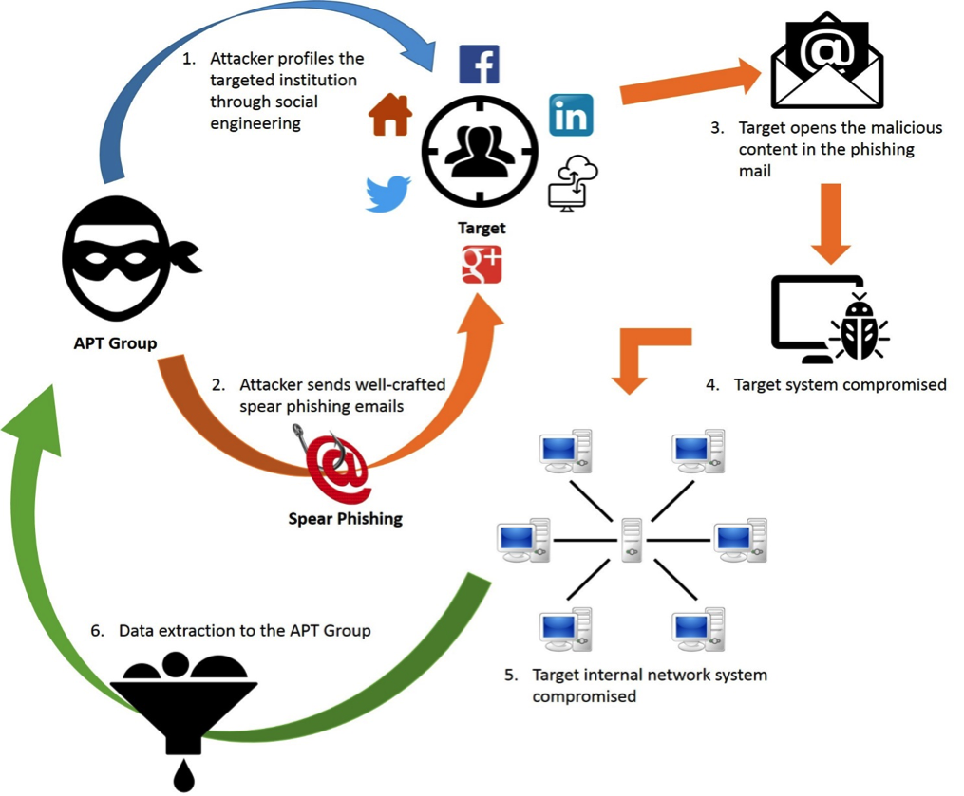
Advanced Persistent Threats

Slide 66
Video
Stuxnet: An Example of an APT
https://www.youtube.com/watch?v=djUHvCyPYhY

Slide 67
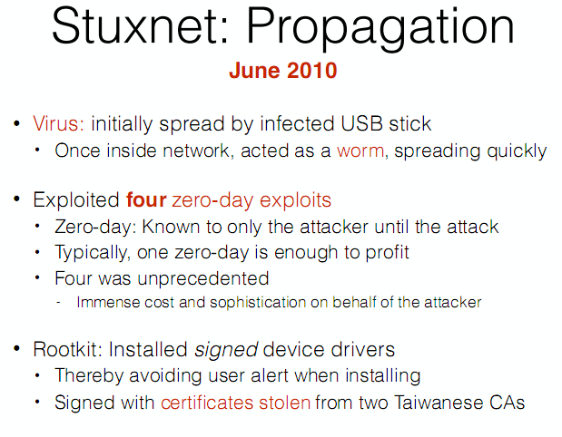
Case Study: Stuxnet

Slide 68
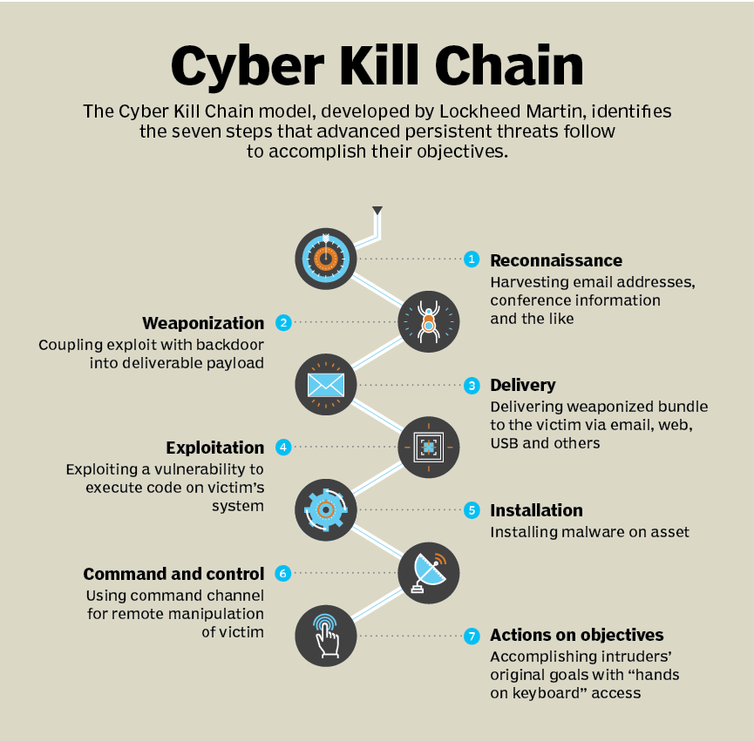
Cyber Kill Chain

Slide 69
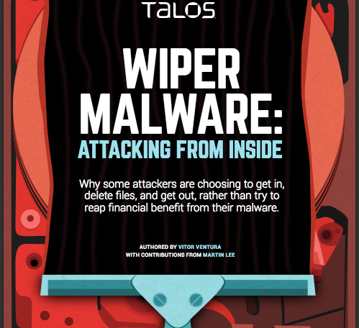
Case Study: WiPEr Malware
https://www.youtube.com/watch?v=HYv15BInzas
Notes:
Required Reading:
https://www.packetlabs.net/posts/how-does-wiper-malware-work/ (For all students)
https://www.fortinet.com/blog/threat-research/the-increasing-wiper-malware-threat (Only for BS CSDF students)

Slide 70
Class activity
Search up one example of a real malware in one of the following categories, and then present it in 2-3 minutes to the rest of the class. Cover the name, year it came, what its purpose was/what sort of attacks it carried out, and how it propagated. You can also cover any other interesting information that you find.
Virus
Worm
Trojan
User mode rootkit
Kernel mode rootkit
Blended threat
Malware that used a packer
Oligomorphic malware
Polymorphic malware
Metamorphic malware
Ransomware
Cryptojacking malware
Fileless malware
Wiper Malware
APT

Slide 71
The relationship between cyber attacks and malware
Attacks may be:
The entrypoint for malware infections
The result of malware payloads executing.

Slide 72

Entrypoints
Social Engineering
Phishing / Vishing/ Spear Phising / Pharming
Spam
Typo Squatting

Slide 73
Malware Payloads (Capabilities)
Collect data
1
Delete data
2
Modify system security settings
3
Launch attacks
4

Slide 74
Malware
Malware Landscape
How do they infect hosts
How do they hide
How do they propagate
The Malware Zoo
How to detect them
Malware categories

Slide 75
Virus signature
Find a string that can identify the virus
Fingerprinting

Slide 76
Heuristics
Analyze program behavior
Network access
File open
Attempt to delete file
Attempt to modify the boot sector
Notes:
Speak of sending mail

Slide 77
Sandbox analysis
Running the executable in a VM
Observe it
File activity
Network
Memory

Slide 78
Dealing with PackerS
Launch the exe
Wait until it is unpacked
Dump the memory

Slide 79
Threat Actors
Introduction to cybercriminals

Slide 80
Who are the Attackers?
Hackers – white, grey or black hat
Cybercriminals
Script Kiddies
Brokers
Insiders
Cyberterrorists
Hactivists
State-sponsored attackers

Slide 81
Insiders

